Slide 1


CLOUD BASED E-SALVATION FOR WOMEN SAFETY
AVULA.ROHITHA 17BLC1007
G.BHAVYA 17BLC1023
ISHAN GOGNA 17BLC1148
ECM3002 CLOUD COMPUTING AND DISTRIBUTED COMPUTING
FACULTY: Dr.SOFANA REKA S

Slide 2
PROBLEM STATEMENT
Women safety, in India is a big concern and a very important social justice issue since the very beginning. There are numerous instances of women being sexually attacked in places like offices, public transports, streets, educational institutions, etc.
Women and girls are facing a tough time due to the country’s current situation; all their liberty is taken away due to such meaningless acts.
Women are drastically growing equally along with men in almost every field, but are dragged down to situations which degrade their development and courage to succeed.

Slide 3
OBJECTIVE
We are designing a one-stop solution which will act as a virtual helper for woman. In this project we will design a social welfare application which is being created on Android platform especially for women from where their closed ones will be able to know about their current location through live tracking i.e. where they are and if they need any help in any situation they can activate the application for their safety.
This Android and Cloud based applications would provide many important features like to get involved with local authorities for improving the condition of unsafe roads and localities.
The goal of the new technology solution that we propose here is to make a significant change in safety issues for women, make them more independent & fearless about how the society reacts in case they had suffered from any such problem in the past.

Slide 4
PROPOSED SYSTEM
Based on the objectives & requirement of the project following block diagram has been proposed :
Police Station
Application
Android
Smartphone
User
Alert Message and GPS Location
Cloud
Database
Panic Button
Panic Button
Microphone
Family Contacts

Slide 5
The Proposed block diagram has been divided into three modules, the first being the reporter module, the second module being the database and the cloud server & the end module is the tracker module.
The first module consists of the “User” making use of the application on an android smartphone. Initially it is required of the user to ‘Sign Up’ for the application by filling in appropriate details. The user has to then go through the authentication step once to use the application. Using the application, user can ‘Add’ emergency contacts which act as tracker module.
The second module consists of the “Cloud Server” and “Database” which are interconnected to each other and to the reporter module and the tracking module. The GPS location of the reporter module is tracked regularly by the cloud server whenever an alert is generated. This location is then sent to the tracker module contacts via the server. The database stores all the information the user uploads in the application.
The third module is the “Tracker Module” which can track the reporter module. The tracker module will receive a message in case of emergency.

Slide 6
METHODOLOGY
Add Contacts : User can Add a minimum three emergency contacts of her family and friends into the application.
With the app activation, it generates a Unique Request ID and sends an SMS/Call Alert to the saved emergency contacts mentioning the exact location of the user with longitude & latitude values.
After the application activates, an auto-call goes to the Police on 100. This increases the safety measures bringing police into action quickly.
Here we are using Android Studio to create an app and “Codelab”, is an introduction to Google Cloud Endpoints, the technology that enables the publication of RESTful APIs which can easily be consumed by Android applications. In this codelab we will use Android Studio to build a brand new Google Cloud Platform backend to store user tasks

Slide 7
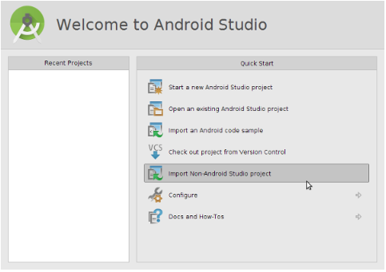
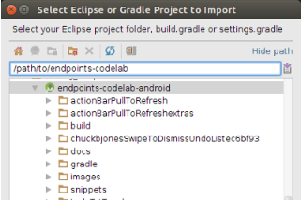
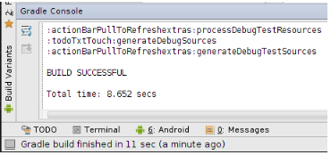
Step -1 : Open Android Studio and Import Non-Android Studio project
This will trigger a successful (Gradle) build:

Slide 8
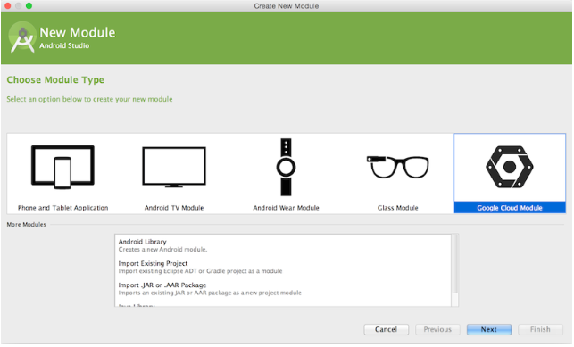

Step – 2 : Create the Endpoints backend project (Android Studio has built-in support for Google Cloud Endpoints)
To add a backend to the current Android project, go to: File > New Module and choose "Google Cloud Module".
This creates a new backend Gradle module for the Android Studio project and adds it as an additional dependency in the settings.gradle file. It also adds the required dependencies for the generated client libraries to the app's build.gradle file. Start the development app server by pressing the green "Play" button. Once the development app server has started you should see this log message:

Slide 9
At this point we have the basic Endpoints infrastructure in place but we still need to store tasks in a persistent Datastore and wire up the Android application to use this new backend.
Step – 3 :Modify the Android application to use the new backend. Run. Test. Repeat.
While exposing standard RESTful interfaces makes it possible to access them from an Android application using HTTP/JSON calls, the Cloud Endpoints technology is able to create client libraries (in our case a Java library) to enable a much easier implementation on the client-side with high-level abstractions such as Java classes rather than the underlying JSON and HTTP concepts. To generate these client libraries, we can re-build the backend.
Android client application is now ready to start using the Endpoints client library to store tasks in our Google Cloud backend! The pushToRemote and pullToRemote methods implement the actual communication with the backend which we set to use the new Cloud Endpoints-powered backend. Create a new subclass of TaskBagImpl called EndpointsTaskBagImpl
The very last step is to switch the Android client to use this new subclass implementation. This is done in the TaskBagFactory class.
return new EndpointsTaskBagImpl(sharedPreferences,localFileTaskRepository);

Slide 10
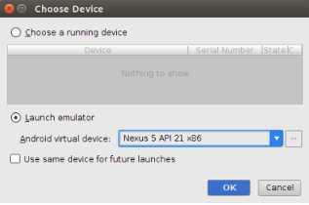
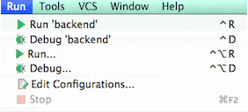
Make sure the backend is running, and select the module and press Run. If we don't have the emulator running, this should bring up this dialog:
Click OK and wait for the emulator to start. Once started, we can start using the application . We can now run and test the backend locally, and deploy the backend using Android Studio. To run the backend template locally:
Click Run > Edit Configurations to open the Run/Debug Configurations form .
In the left pane, under App Engine DevAppServer, locate the backend module we added, select it, and click OK.
Click Build > Rebuild Project and wait for the build to finish.
Select Run > <backend-module-name> to launch the backend in the local App Engine development server in Android Studio

Slide 11
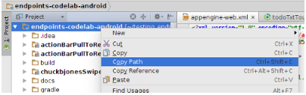
5. Wait for the backend to start up in the development server; when it finishes loading, a message is displayed in the console. At this point, the default backend from the template is successfully running. However, Android app is not yet connected to the backend. To access the backend, we need to add some code to the Android app.
6. Now, navigate to the build.gradle file at the root of the module and we should make sure that the appengine section contains this authorization attribute which will allow Gradle to propagate the Google Cloud OAuth2 credentials to deploy the backend to Google App Engine.
7. Now open a terminal window and set the directory to the root of the project (select the top node and Edit > Copy Path).
8. On the command line type the command : ./gradlew WomensafetyTxtBackend:appengineUpdate.
9. Once the backend is successfully deployed, we now go back to the console.developers.google.com and check the dashboard, current application version, logs, etc.
10. Rebuilding the Android application will pick up the changes made to the backend so we don't need to explicitly re-install the Endpoints client libraries.
11. Now run the Android client one more time

Slide 12
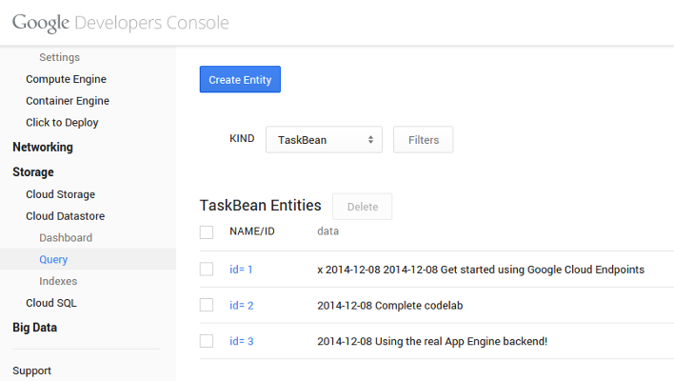
As you can see in the screenshot above a query of TaskBean entities in the Cloud Datastore returns the list of tasks in our application!

Slide 13
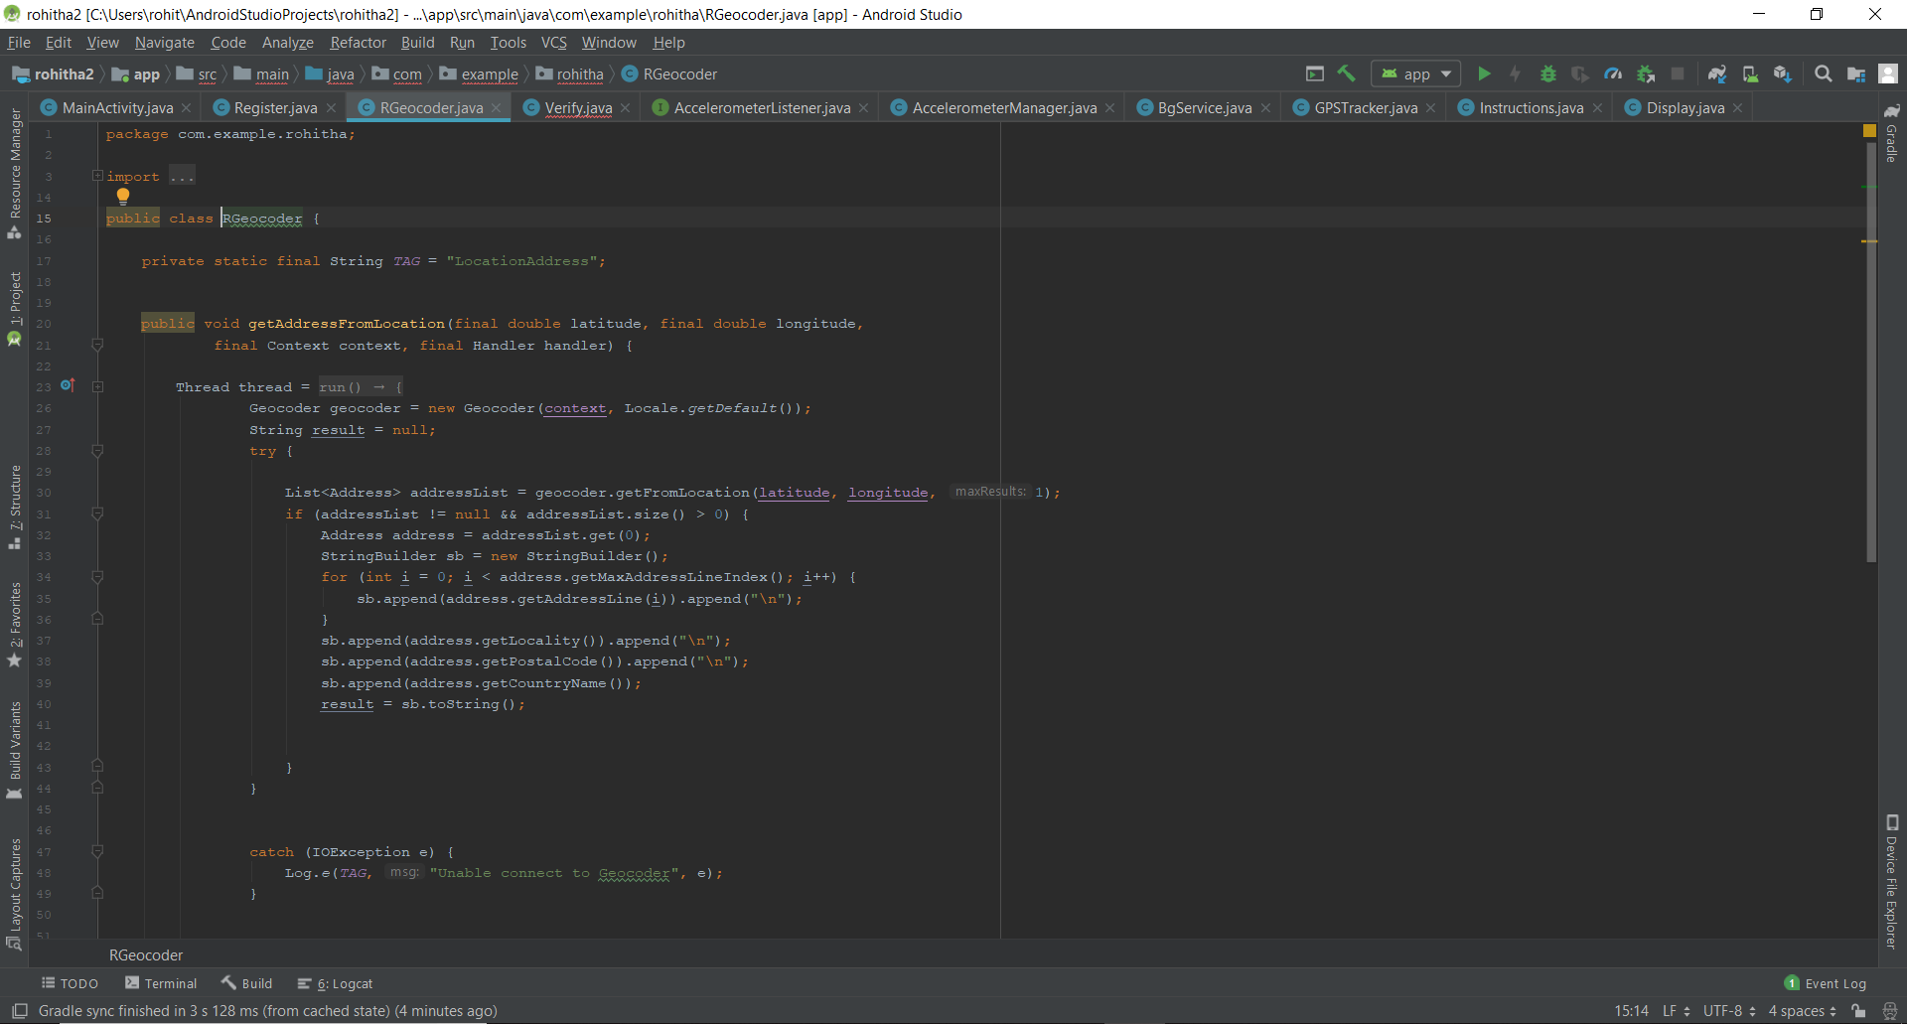
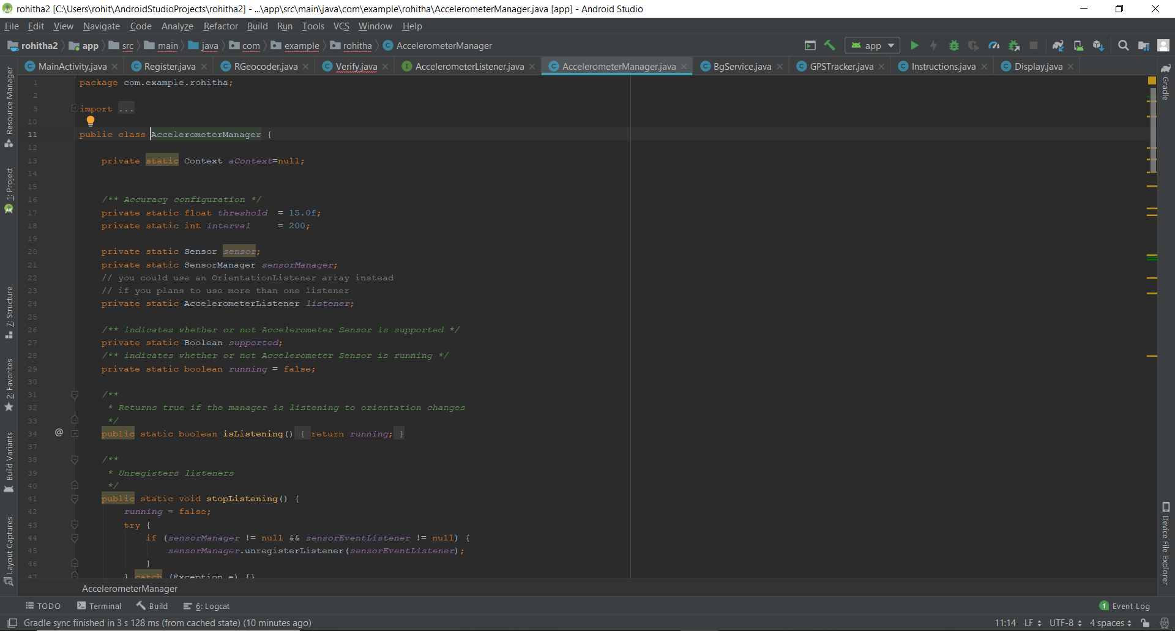
SCREENSHOTS IN ANDROID STUDIO

Slide 14
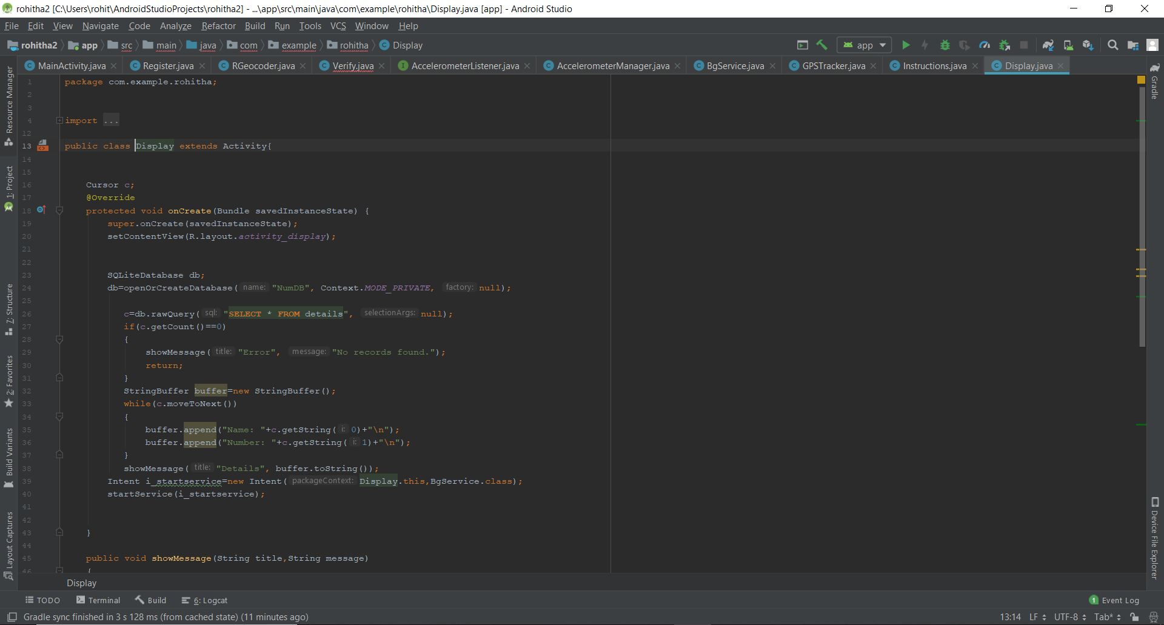
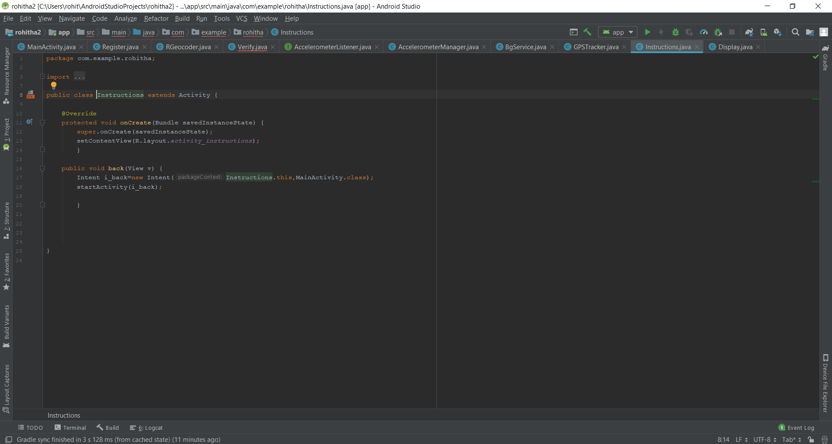
>>Continue

Slide 15
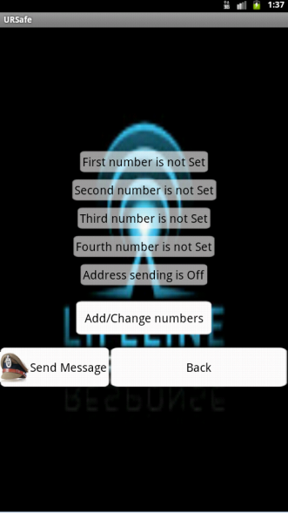
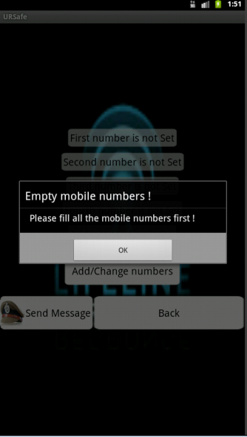
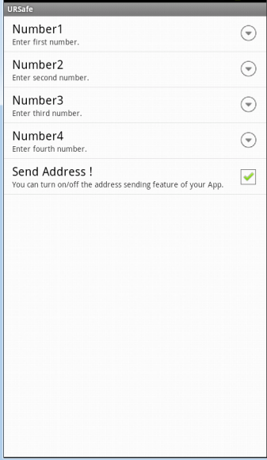
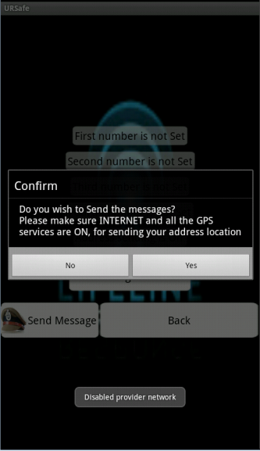
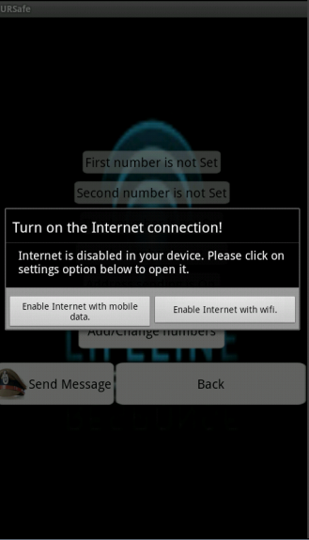
RESULTS

Slide 16
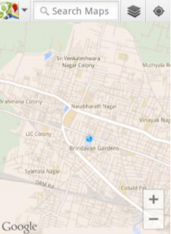
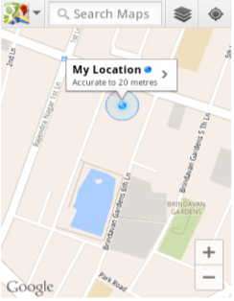
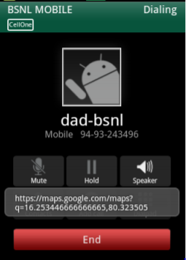
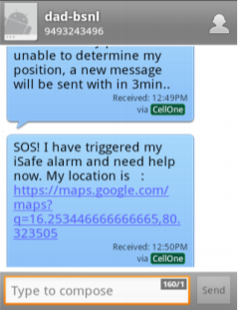
GOOGLE MAP AND SOS

Slide 17
APPLICATIONS
The android and cloud based solution can be used for empowering the women through Women Safety Application, the virtual helper.
Improvement in condition of unsafe localities by sharing the information regarding it with concerned authorities through the application.
This application sends the live location of the user.
Disadvantages :
This application requires active internet connection.
User needs to put correct data or else it behaves abnormally.
3. All the existing systems must be connected to the GPRS service to work properly, hence cannot be used during emergency if there is no internet connectivity.

Slide 18
CONCLUSION
In this project, the potential of using a software based solution for safety of women is investigated. A Women’s Safety Application is a step in the right direction as it empowers women, rather than forcing them to live in fear or isolation. The women will become less dependent on other people by using the Application as Virtual Helper. The App helps the women & judiciary in punishing the criminals on a fast-track in case of any incidence. Also, the features implementing this goal will provide confidence and support to the women using the application. This application has the potential to win over these problems & make women feel free of all worries in the society. The system is highly scalable and user friendly. This system will help in prevention of attacks on women and being victim of any sex scandal.

Slide 19
REFERENCES
Akshata V.S.1, Rumana Pathan2, Poor nima Patil3 and Farjana Nadaf4 , B’Safe & B’Secure The Door to Safety Swings, Department of Computer Science Engineering, KLS’s VDRIT, Haliyal, India, (IJCEM), ISSN: 2348 9510 Volume 1, Issue 7, October 2014.
S.Sangeetha1,P.Radhika PG scholar, Application For Women Safety,Department Of MCA, Panimalar Engineering College,IOSR,ISSN:2278-0661,pISSN:2278-8727, Volume 17,ISSUE 3, Ver.IV(May-Jun.2015),pp01-04.
Suraksha. A device to help women in distress: An initiative by a student of ITM University Gurgaon. efytimes.com. 2013. Available from: http://efytimes.com/e1/118387/SURAKSHA-A-Device-To-Help-Women-In-Distress-An-Initiative-By-A-Student-Of-ITM-University-Gurgaon.pdf
http://timesofindia.indiatimes.com/topic/mobile-apps-for-women's-safety
Bramarambika Thota , Udaya Kanchana Kumar .P, Sauver: An Android Application For Women Safety, MTech , Dept.Of ECE ,Vignan University , Guntur , India , M.sc , Computer Science , TJPS Colege,Guntur,India ,IJTEEE ,ISSN:2347-4289.VOL 3,ISSUE 05.
Android Based Safety Triggering Application P.Kalyanchakravarthy1, T.Lakshmi2 ,R.Rupavathi2, S.Krishnadilip2, P.Lakshmankumar2,Assitant Professor1, BTech Student CSE Department, Lendi Institute Of Engineering & Technology,Affilitated by, JNTUK,Jonada, Vizayanagaram, Andhra Pradesh, India, IJCSIT , ISSN: 0975-9646,Vol. 5(1),2014,646- 647

